Slide 1
LAMBDA EXPRESSION

Slide 2
TABLE OF CONTENTS
Definition of lambda expression
Examples of lambda expression
Pass by value
Pass by pointer

Slide 3
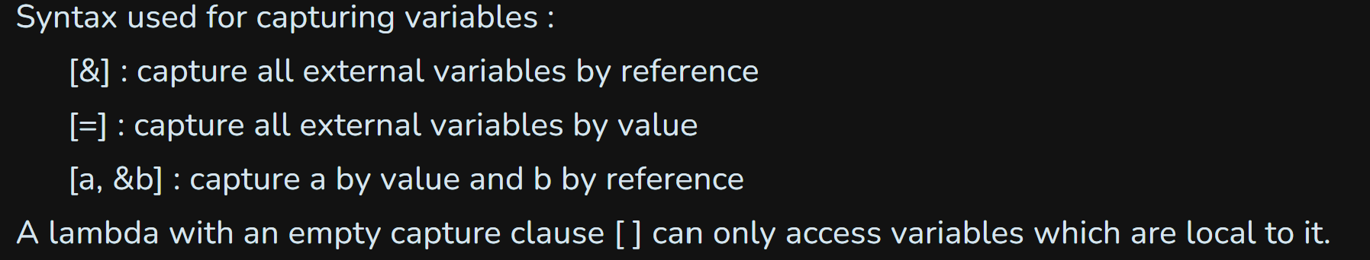
DEFINITION
Lambda expressions to allow inline functions which can be used for short snippets of code that are not going to be reused and therefore do not require a name. In their simplest form a lambda expression can be defined as follows:
[ capture clause ] (parameters) -> return-type
{
definition of method
}
Generally, the return-type in lambda expressions is evaluated by the compiler itself and we don’t need to specify it explicitly. Also the -> return-type part can be ignored. However, in some complex cases e.g. conditional statements, the compiler can’t determine the return type and explicit specification is required.

Slide 4
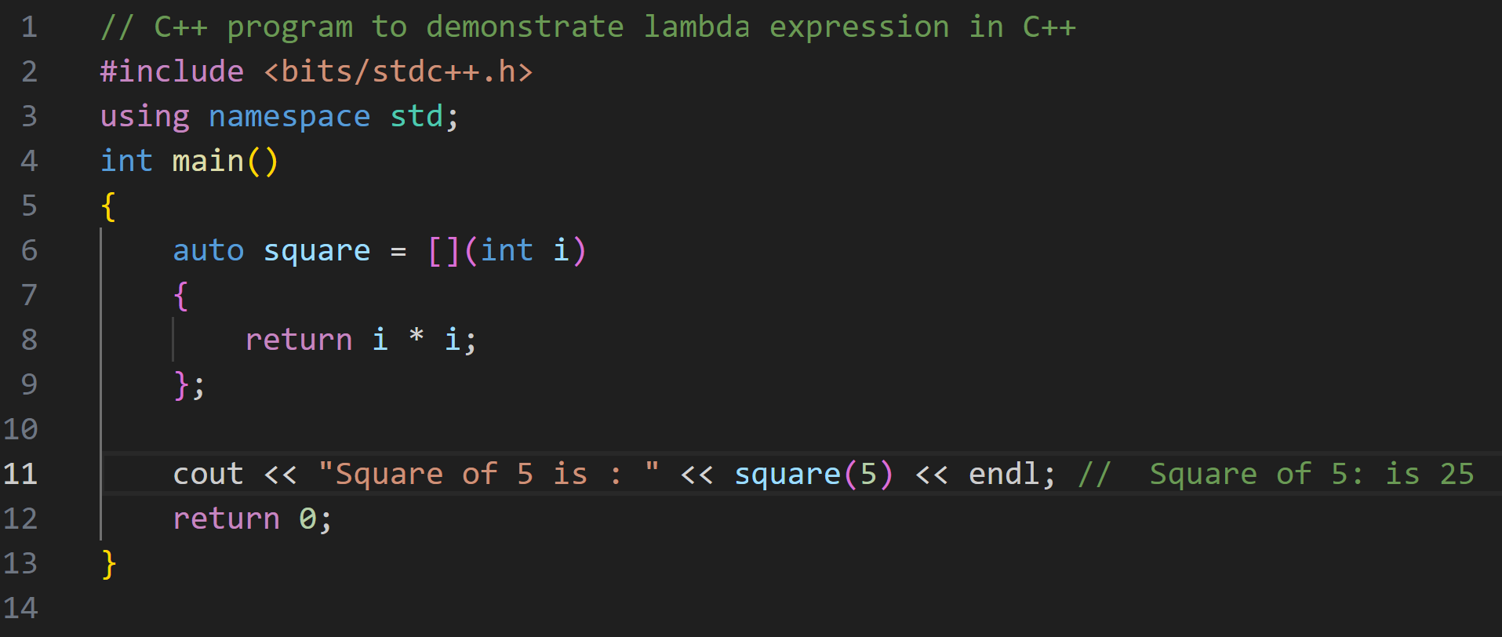
EXAMPLE OF LAMBDA

Slide 5
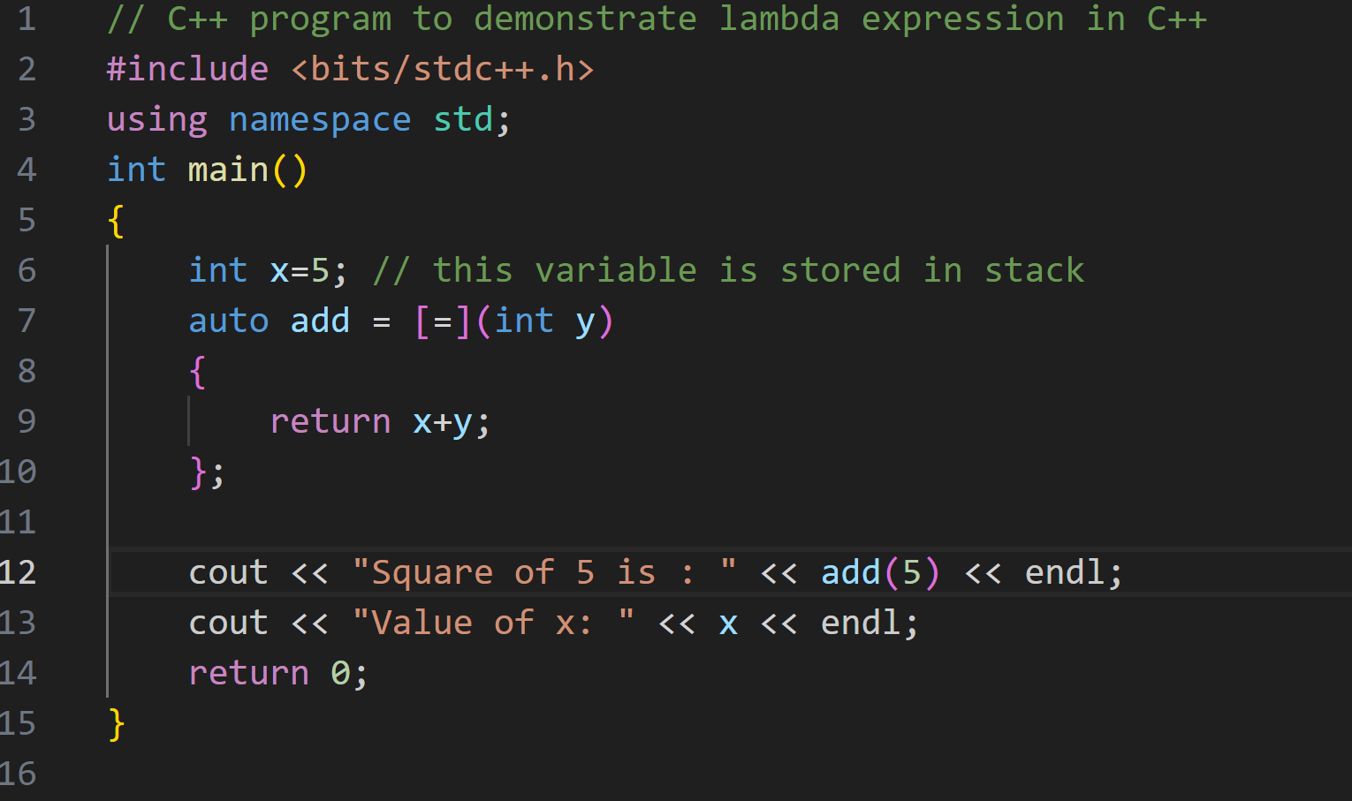
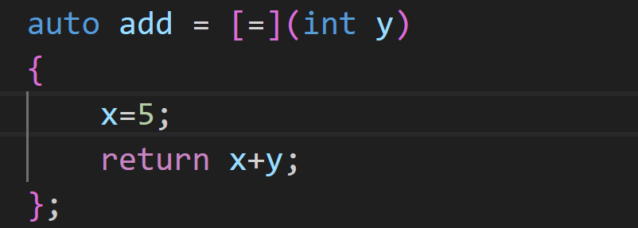
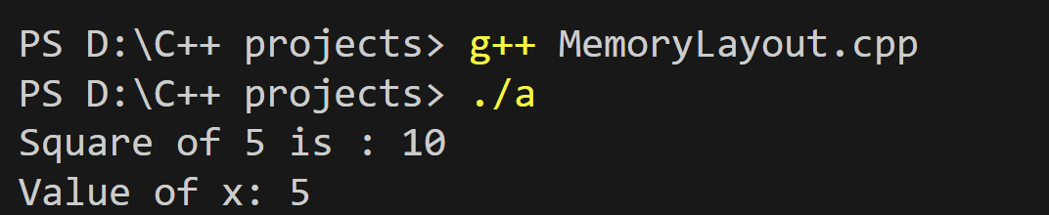
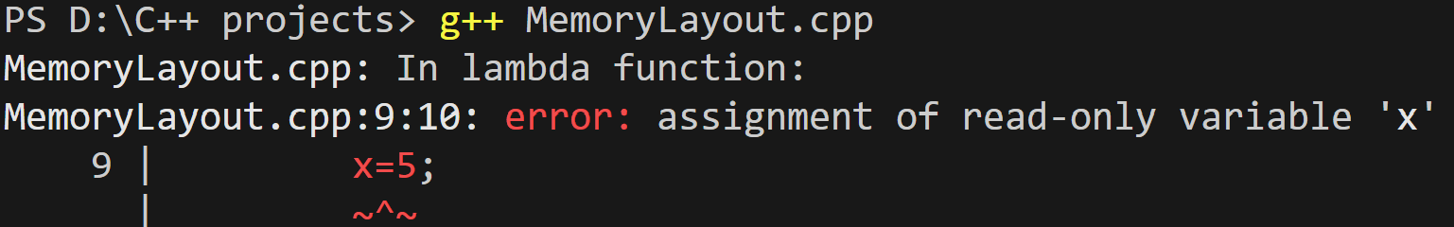
PASS BY VALUE
Capture is "=".
When we pass by value, the value will be coppy on the stack and we can use it in lambda expression but we can't change the value of this variable.
If we tried to change this variable, this lead to error

Slide 6
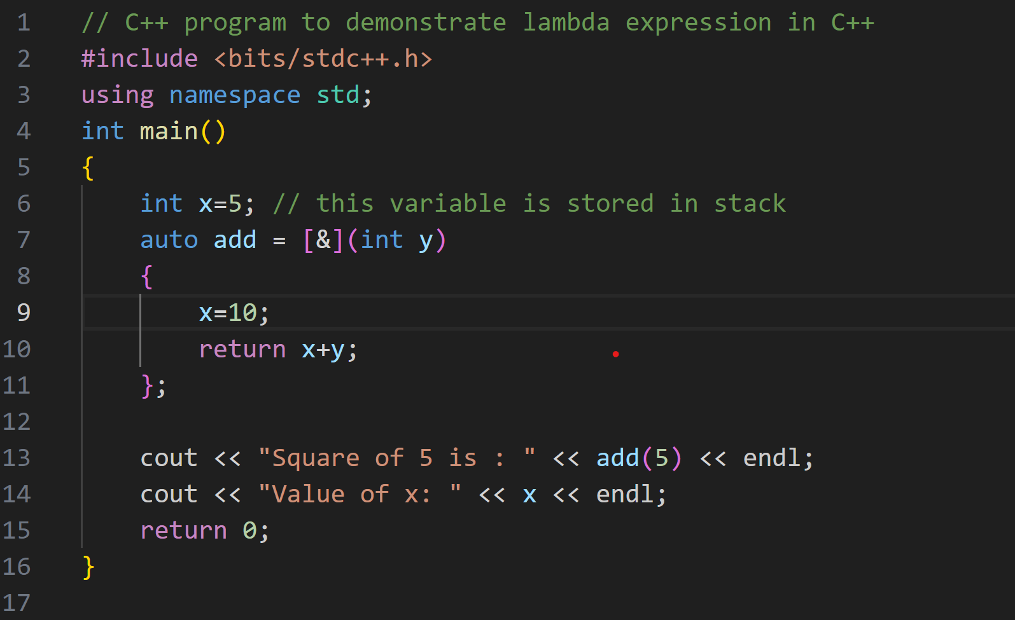
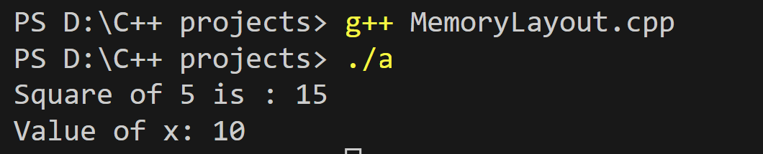
PASS BY REFERENCE
Capture is "&", khi truyền tham chiếu thì lambda object sẽ lưu địa chỉ gốc của biến và chúng ta có thể thay đổi giá trị trực tiếp của biến đó trong hàm lambda.

Slide 7
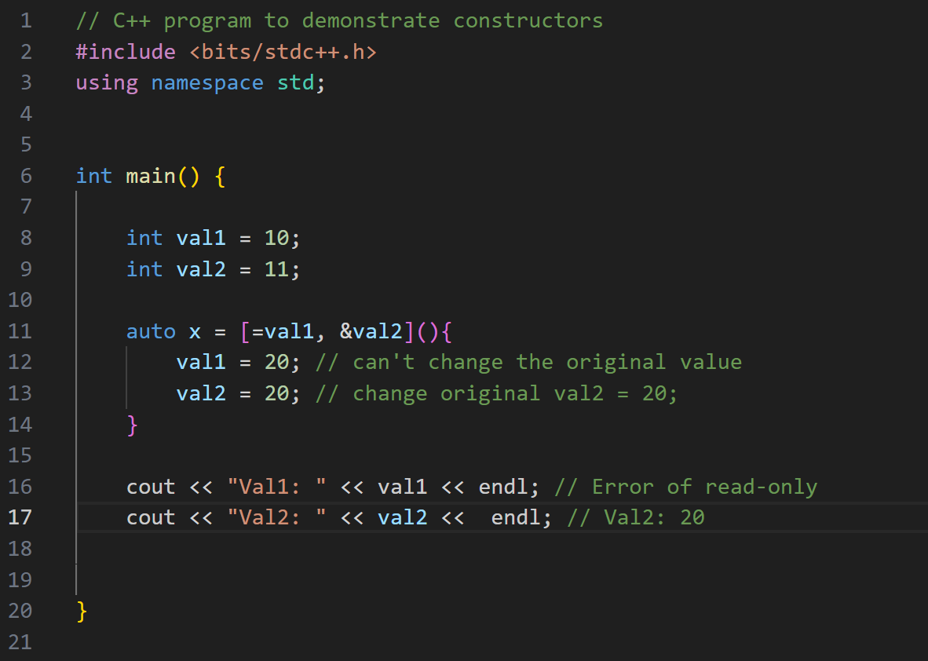
COMBINE PASS BY VALUE AND REFERENCE

Slide 8
LAMBDA EXPRESSION VS POINTER FUNCTION
Lambda expressions can capture variables from the enclosing scope, whereas pointer functions cannot. This means that lambda expressions can access and modify local variables, whereas pointer functions can only use global variables or parameters.
Lambda expressions can be defined inline, whereas pointer functions need to be defined separately. This means that lambda expressions can be more concise and convenient, whereas pointer functions can be more reusable and modular.
Lambda expressions can have different types depending on the captured variables and the return type, whereas pointer functions have a fixed type based on the parameters and the return type. This means that lambda expressions can be more flexible and adaptable, whereas pointer functions can be more consistent and predictable.

